Slide 1

Principles of communications
Chapter 3 Channel—Part II
Channel Capacity
信道容量

Slide 2
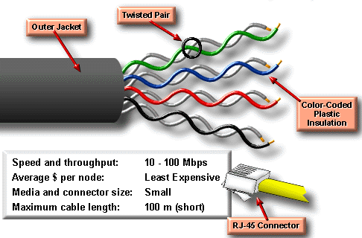
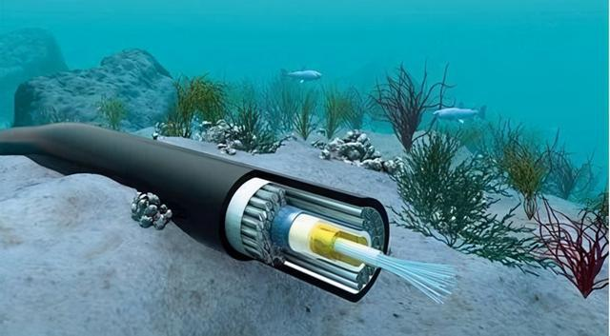
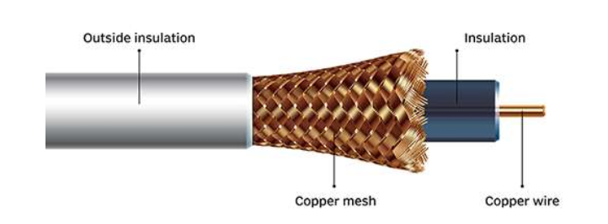
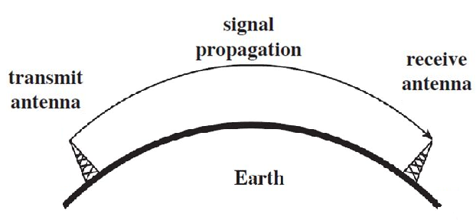
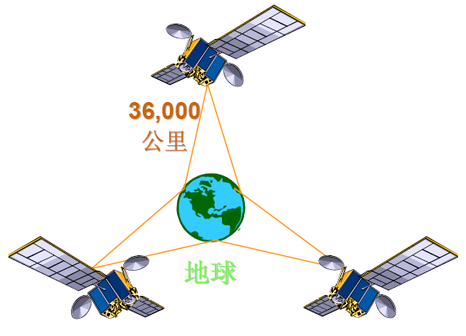
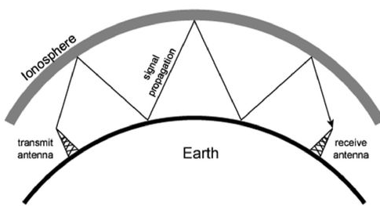
Chapter 3: Channel — Part II
Twisted pairs
Optical Fiber
Coaxial cable
Satellite
(LOS)
Ground wave
Short Wave

Slide 3

Channel bandwidth B and Information rate Rb
Channel bandwidth B is a key parameter in communication systems, describing the ability of a communication channel to transmit signals or data.
      Information rate Rb：
      the average information content transmitted in unit time, the unit is b/s or bps.
Channel | B (Bandwidth) | Rb​ (bps)
Wifi | Depends on standard (e.g., ~20 - 160 MHz for Wi-Fi 6) | Up to ~9.6 Gbps (Wi-Fi 7)

Slide 4
Discussion
Channel | B (Bandwidth) | Rb​ (bps)
Twisted pairs
Coaxial cable
Optical Fiber
Ground wave
Short Wave
Satellite (LOS)
Wifi

Slide 5
Channel | B (Bandwidth) | Rb​ (bps)
Twisted pairs | ~100/250 MHz | ~1 Gbps
Coaxial cable | ~1 GHz | ~10 Gbps
Optical Fiber | ~THz | ~100 Gbps
Ground wave | ~kHz~MHz | ~Mbps
Short Wave | ~MHz | ~tens kbps
Satellite (LOS) | ~500 MHz~GHz | ~100 Mbps
Wifi | ~20–160 MHz | ~9.6 Gbps
Maximum
Bandwidth is limited by the transmission medium.
Transmission rate has an upper limit called channel capacity.

Slide 6
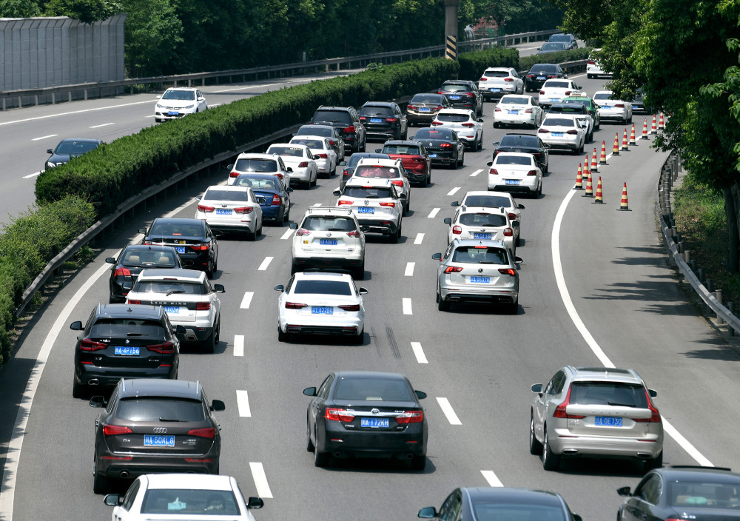
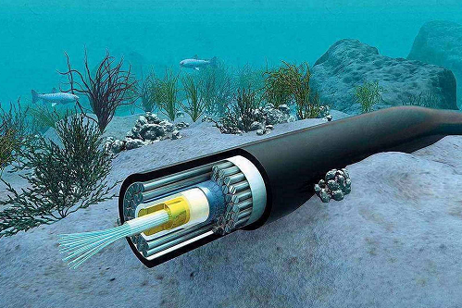
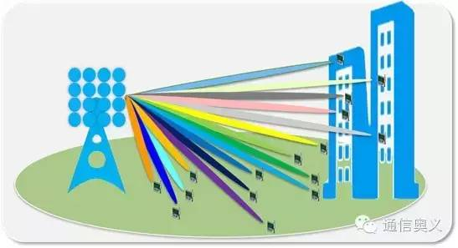
Channel Capacity:信道容量
光缆的最大容量 (信息量)
高速公路最大容量(车辆)
How to compute the channel capacity of a communication system？

Slide 7


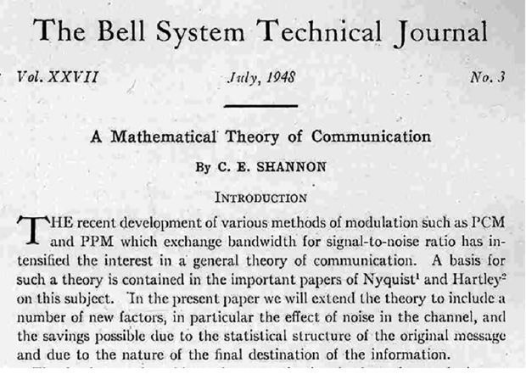
Channel Capacity:信道容量
Shannon theorem 香农定理
A Mathematical Theory of Communication，
The Bell System Technical Journal, 1948
Fifty Years of Shannon Theory，IEEE 1998
天才简史——香农

Slide 8
Channel Capacity:信道容量
Definition
Discrete Channel Capacity 离散信道容量
Continous Channel Capacity 连续信道容量
Examples
Extension 扩展

Slide 9
Channel Capacity:信道容量
Definition
Channel capacity: For a given channel, it is the maximum average information‑transmission rate that can be transmitted error‑free, representing an inherent limiting parameter of the channel itself.(对于给定信道，信道能够无差错传输的最大平均信息速率，是信道本身固有的极限参数。)

Slide 10
Channel Capacity:信道容量
Definition
Discrete Channel Capacity 离散信道容量
Continous Channel Capacity 连续信道容量
Examples
Extension 扩展

Slide 11
Channel Capacity:信道容量
Discrete Channel capacity:离散
P(0 / 0)
Channel
0
0
P(1 / 0)
Transmitter
Receiver
H(x)
H(y)
P(0 / 1)
1
1
H(x/y)
P(1 / 1)

Slide 12
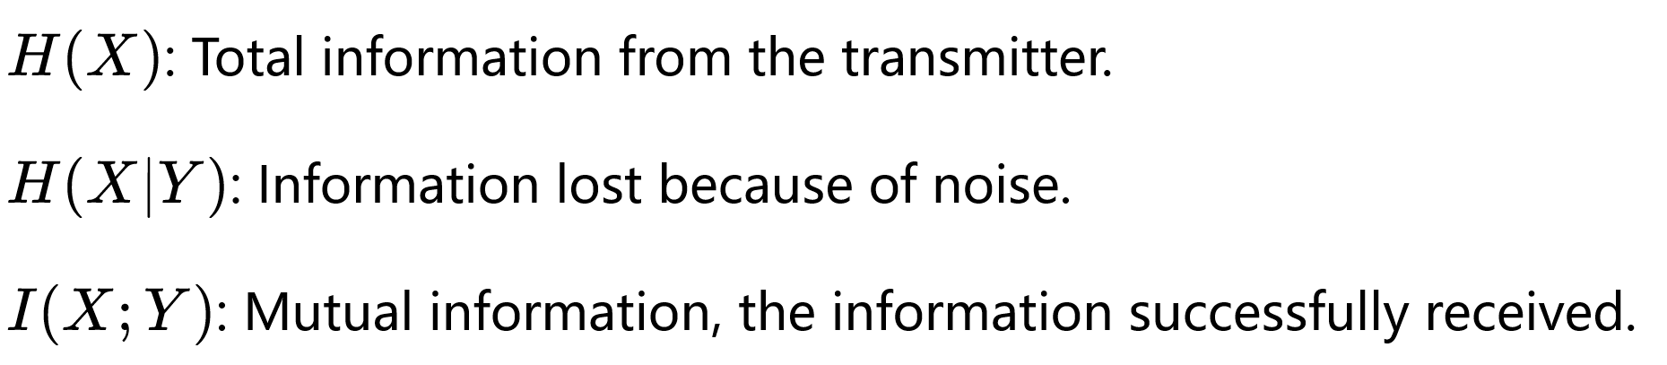
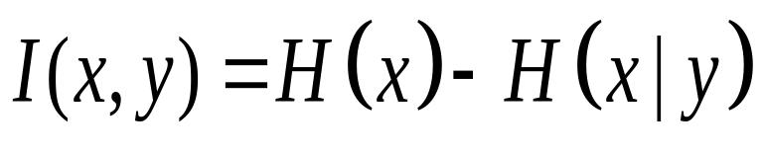
Channel Capacity:信道容量
Discrete Channel capacity:离散
P(0 / 0)
Channel
0
0
P(1 / 0)
Receiver
H(x)
H(y)
Transmitter
P(0 / 1)
1
1
H(x/y)
P(1 / 1)

Slide 13
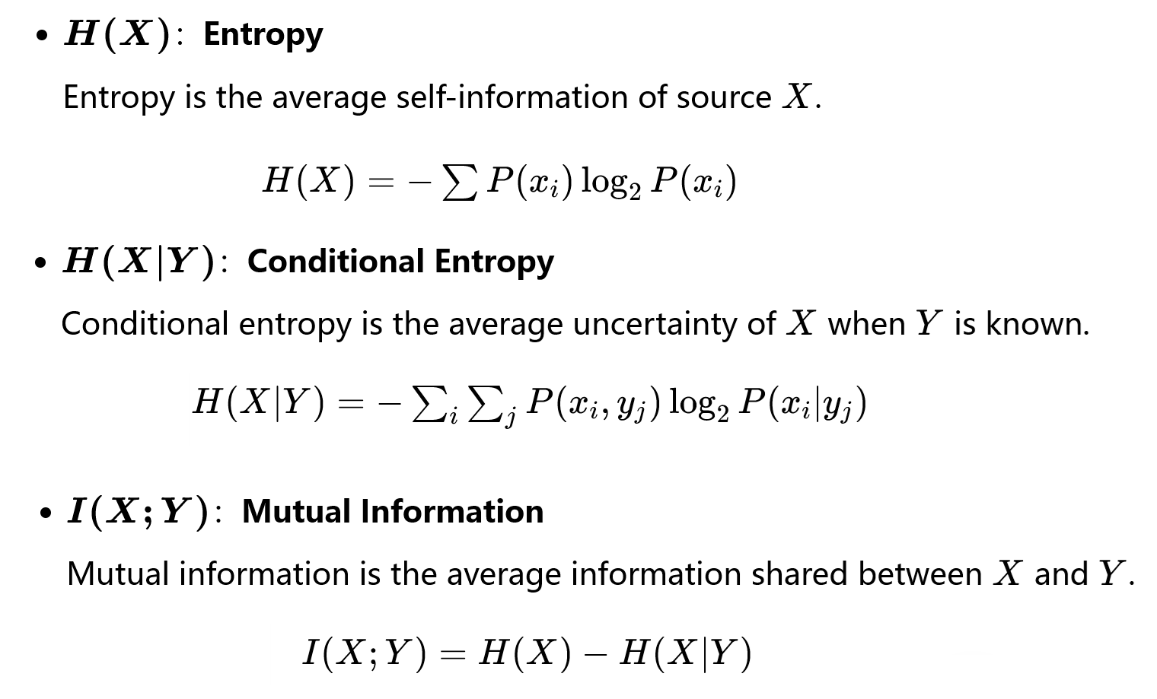
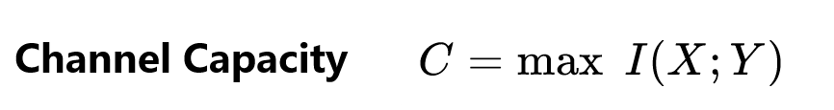
Channel Capacity:信道容量
Discrete Channel capacity:离散

Slide 14
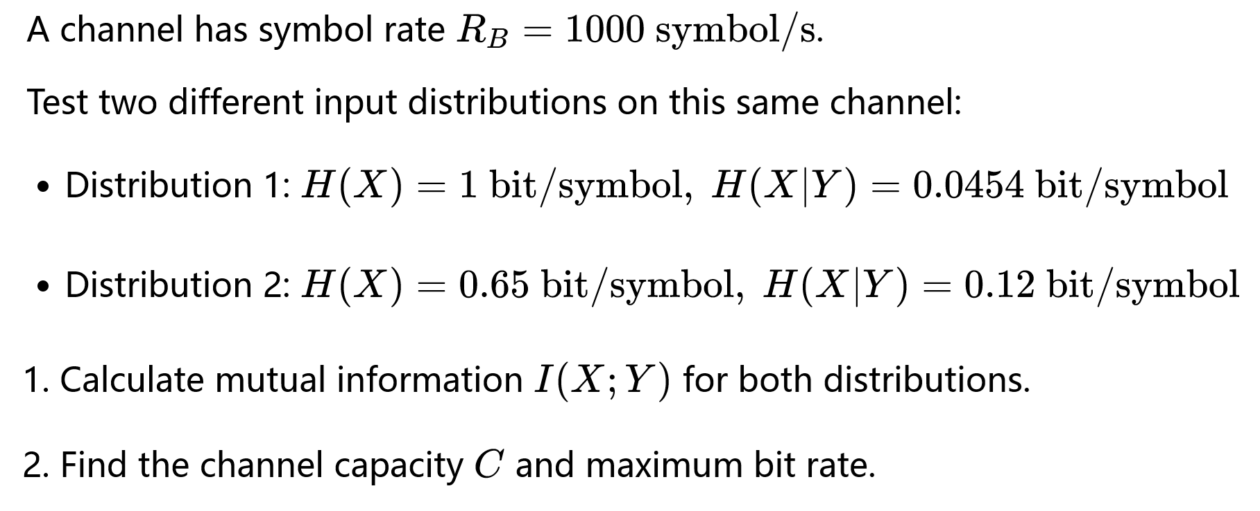
Discrete Channel capacity——example

Slide 15
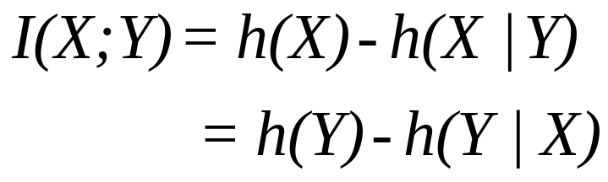
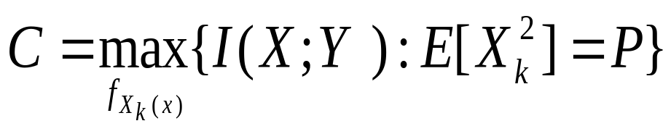
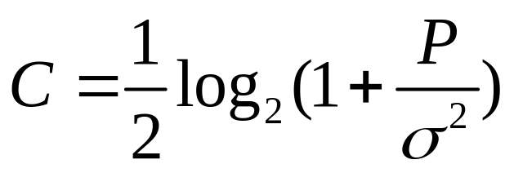
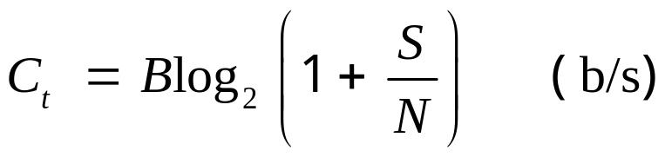
Channel Capacity:信道容量
Shannon-Hartley theorem 香农-哈特利定理
Mutual information
—Hartley Y1928
Gaussian
distribution
Nyquist rate
K=2BT
Unit time is K/T
—Shannon Y1948

Slide 16
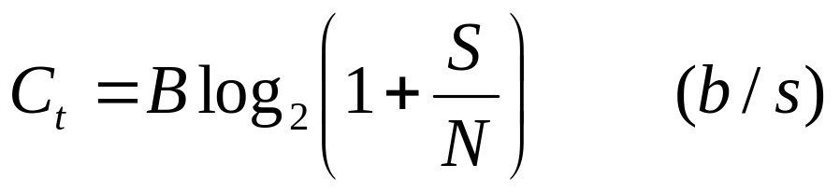
Channel Capacity:信道容量
Shannon-Hartley theorem 香农-哈特利定理
For a continuous additive white Gaussian noise (AWGN) channel, the channel capacity is:
    Where S － average transmitted power（W）
    N－ noise power（W）
    B－channel bandwidth（Hz）
What is the difference
between discrete and continuous channel capacity?

Slide 17
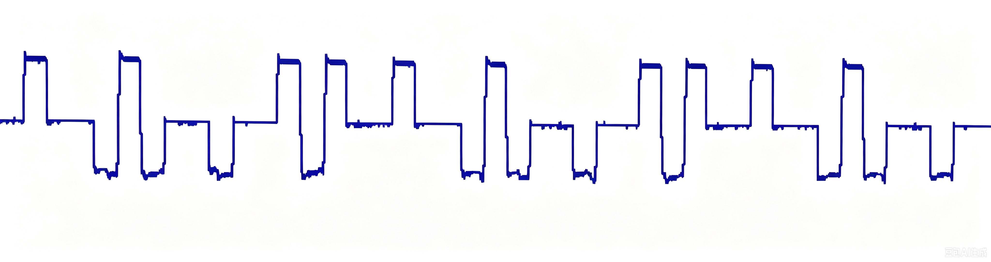
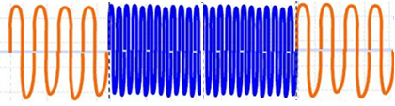
3.2 Channel models 信道模型
--Modulation channel model（调制解调模型）
--Coding channel model（编码信道模型）
Source of information
User of information
Source encoder
Source decoder
Encryption
Decryption
Channel encoder
Channel decoder
Modulator
Demodulator
channel
Noise
Modulation channel
Coding channel

Slide 18
3.2 Channel models 信道模型
--Modulation channel model（调制解调模型）
--Coding channel model（编码信道模型）
The modulation channel is a real physical channel,
while the coding channel is merely an abstract model with statistical properties.
Channel encoder
Channel decoder
Modulator
Demodulator
channel
Noise
Modulation channel
Coding channel

Slide 19
Channel Capacity:信道容量
Discrete Channel Capacity 离散信道容量
离散信道模型：高层抽象
用转移概率表征物理介质带来的差错。
Continous Channel Capacity 连续信道容量
连续 AWGN 信道模型：底层物理视角
直接使用带宽、功率、噪声功率这些物理介质参数。

Slide 20
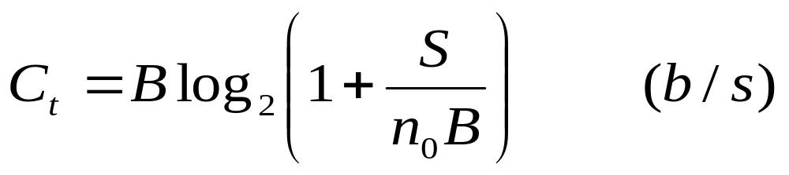
Channel capacity——香农定理
For a continuous additive white Gaussian noise (AWGN) channel, the channel capacity is:
    Where S － average transmitted power（W）
    N－ noise power（W）
    B－channel bandwidth（Hz）
    Suppose single power spectral density is n₀，N = n₀B.
    The channel capacity can be rewritten as：
    From the above equation, the capacity of a continuous channel depends on
    three factors: channel bandwidth B, signal power S, and noise’s PSD no.
三要素

Slide 21
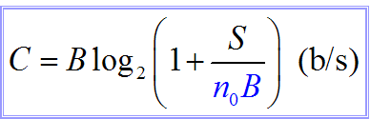
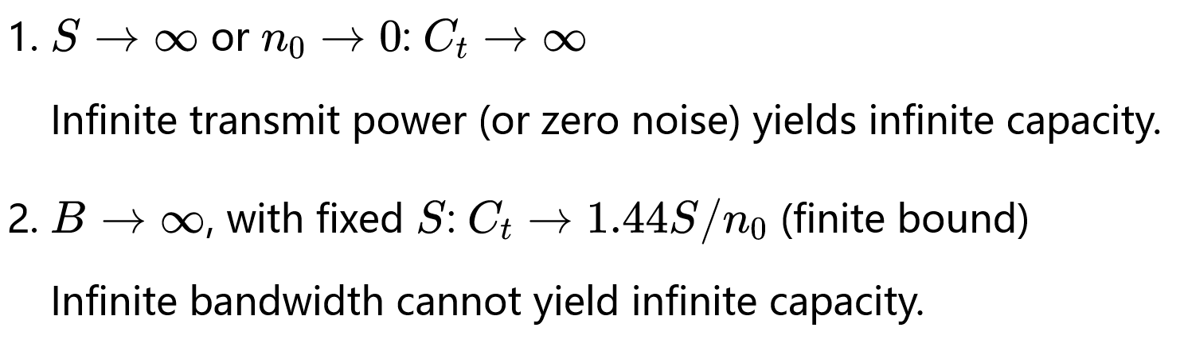
Notes:
香农公式给出了通信系统所能达到的极限信息传输速率，但是，香农公式只证明了理想通信系统的“存在性”，却没有指出这种通信系统的实现方法。

Slide 22
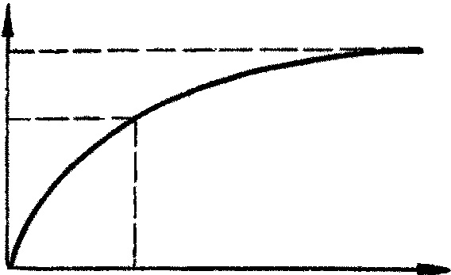
C_{t}
1.44(S/n₀)
S/n₀
B
S/n₀
Figure The relation between C and B
Notes:
香农公式给出了通信系统所能达到的极限信息传输速率，但是，香农公式只证明了理想通信系统的“存在性”，却没有指出这种通信系统的实现方法。

Slide 23
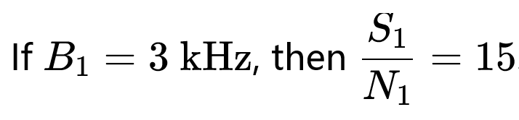

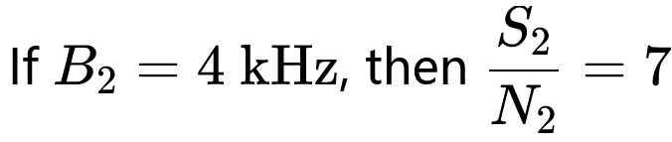
Example
Reduce the requirement on SNR
Conclusion:B and S/N can be traded off.
带宽和信噪比可以互换
Notes:
香农公式给出了通信系统所能达到的极限信息传输速率，但是，香农公式只证明了理想通信系统的“存在性”，却没有指出这种通信系统的实现方法。

Slide 24
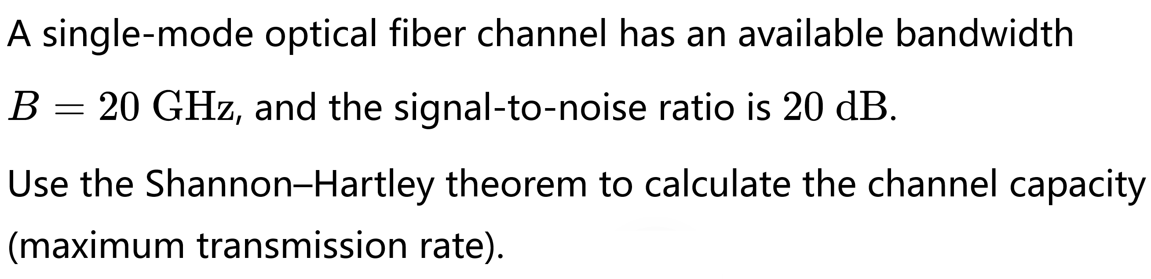
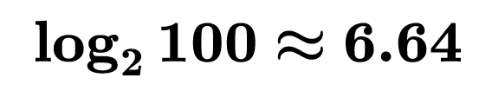
3.4 Channel capacity——Examples

Slide 25
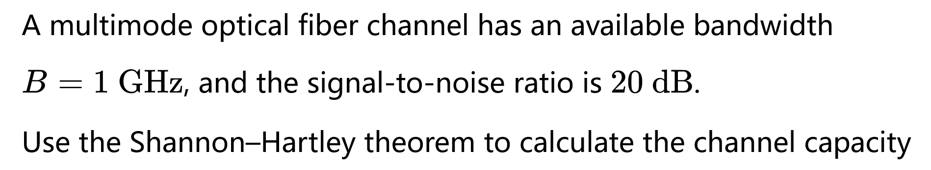
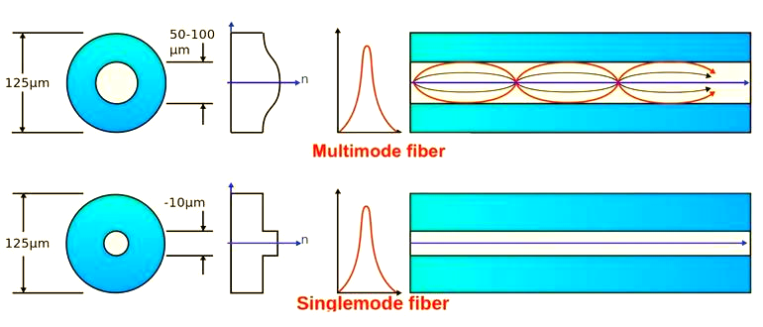
3.4 Channel capacity——Examples

Slide 26
3 (25年期末) A geosynchronous satellite同步卫星 communication link has a carrier frequency of 14 GHz, the system bandwidth is 36 MHz between the transmitter and the receiver, and a signal to-noise ratio (SNR) of 30dB at the receiver.① Calculate the channel capacity.
(提示: The SNR in dB must first be converted to a linear value.)
②If the satellite communication link is affected by space rain attenuation, resulting in the receiver SNR dropping to 10dB while the bandwidth remains unchanged, how will the channel capacity change, calculate it.

Slide 27
③What intuitive impact(影响) does this change have on the service bearing capacity(服务承载能力) of satellite communication (e.g., high-definition video transmission高清视频传输, large data backhaul大数据回传)? 即简单讨论对通信服务质量的影响。

Slide 28
Channel Capacity:信道容量
Definition
Discrete Channel Capacity 离散信道容量
Continous Channel Capacity 连续信道容量
Examples
Extension 扩展

Slide 29
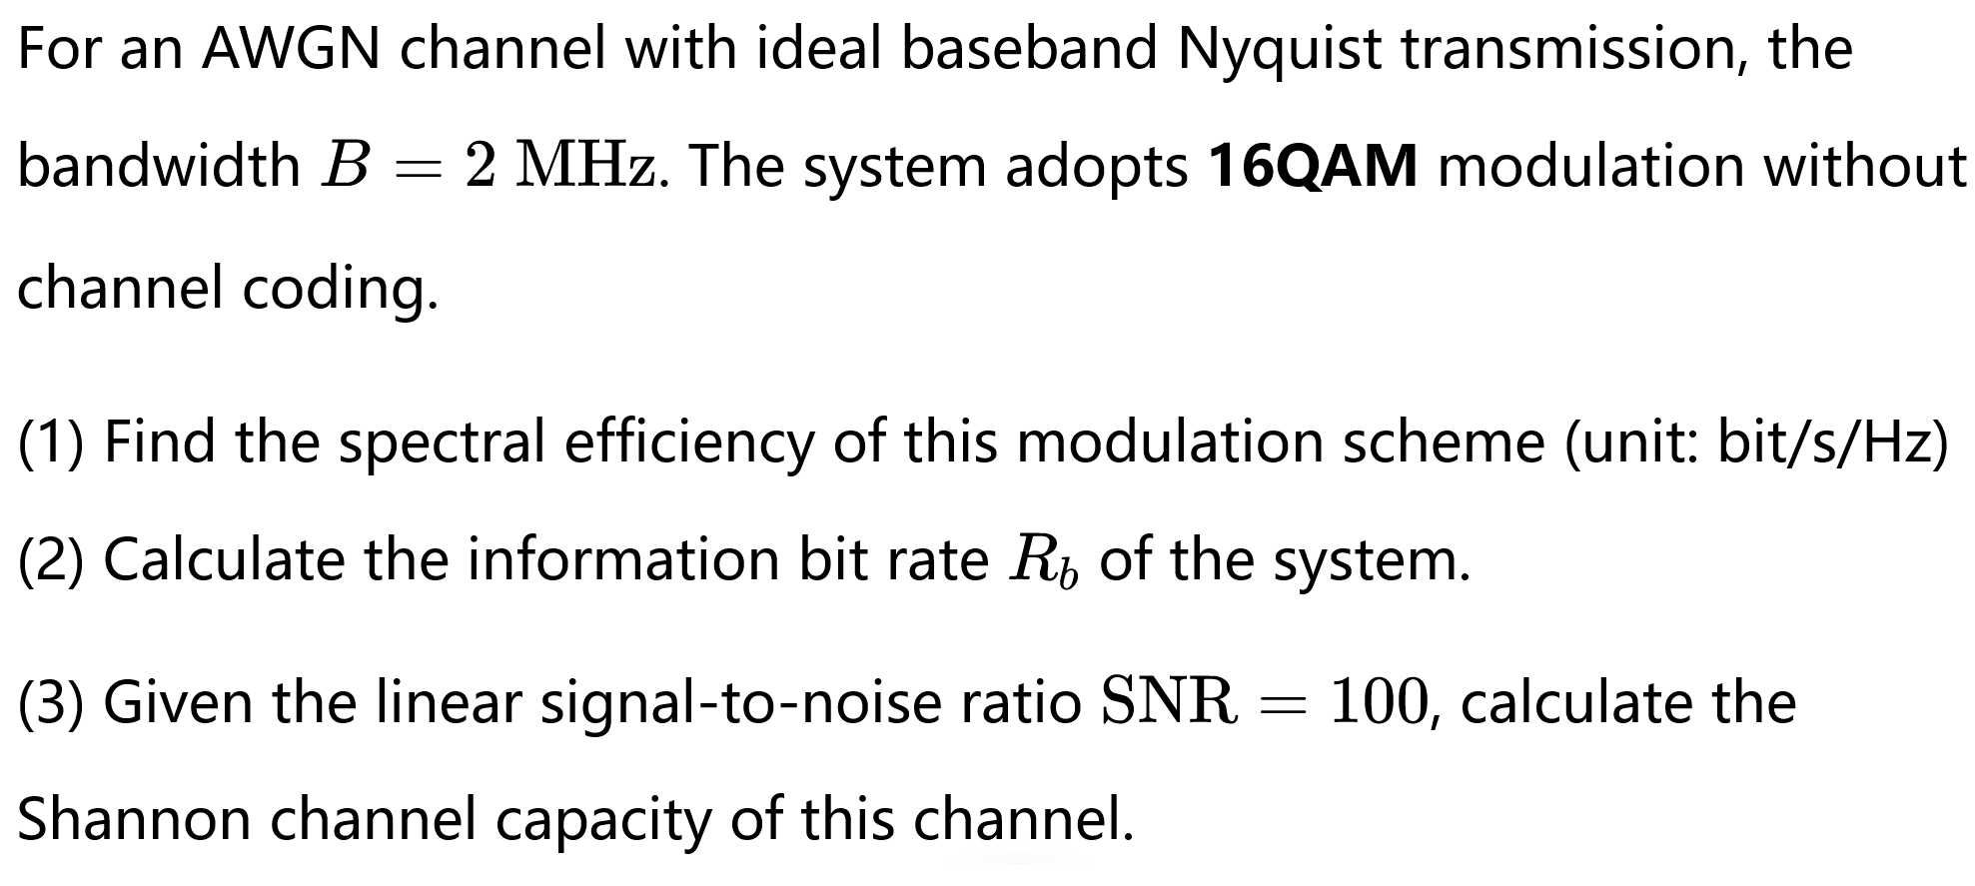
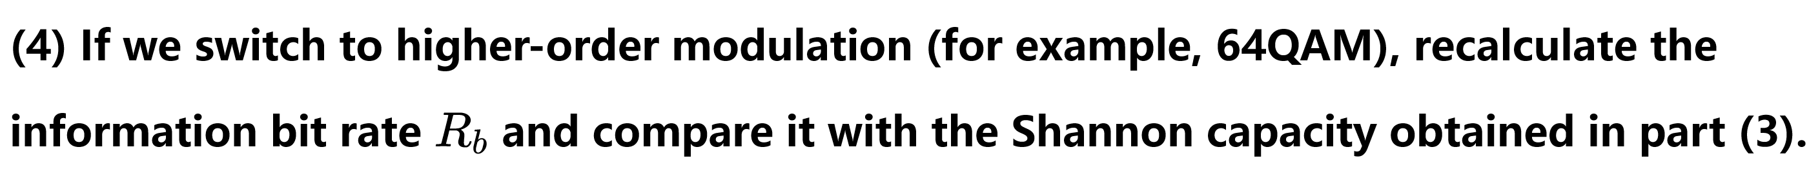
Extension 拓展——example

Slide 30
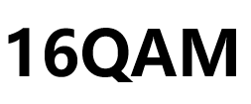

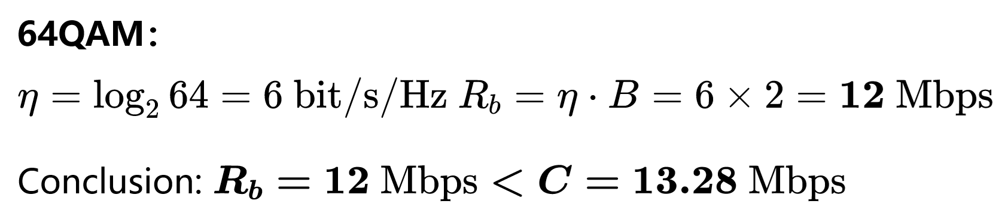
Higher-order modulation gets closer to channel capacity.
Higher-order modulation brings higher BER, and good channel coding is needed to improve the reliability of the communication system.
高阶调制误码率更高，需要优良的信道编码来提升通信系统的可靠性。

Slide 31
Modulation: improves communication effectiveness (faster transmission, higher spectral efficiency)
Channel coding: guarantees communication reliability (accurate transmission, lower bit error rate)
调制：提升通信有效性（传得快，频谱效率）
信道编码：保障通信可靠性（传得准，降低误码）

Slide 32
Extension 拓展：MIMO communication
Transmitter
Receiver
. . .
. . .
MIMO Communication System
MIMO multiplexing复用: multiple antennas send different information to multiply data rate.多天线传输相互独立的信息，信息传输速率可以成倍提升。
MIMO diversity 分集: multiple antennas send the same information to enhance system reliability.多天线发送相同信息，增强系统可靠性。

Slide 33
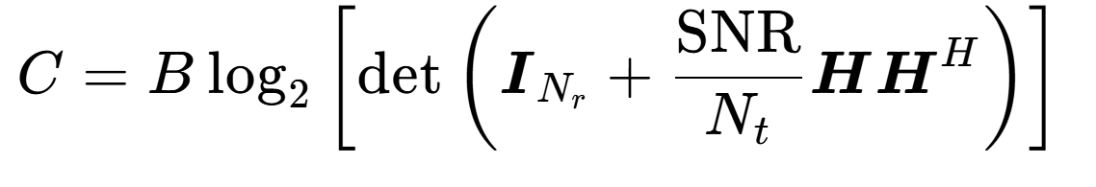
Extension 拓展：MIMO communication
The standard channel capacity formula for MIMO:
Transmitter
Receiver
. . .
. . .
MIMO Communication System

Slide 34
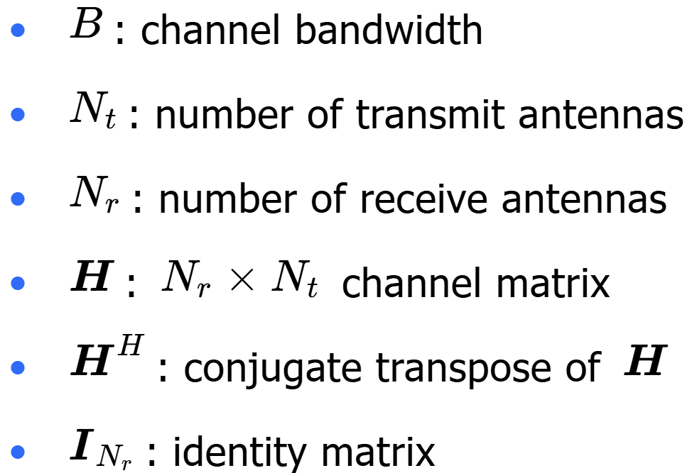
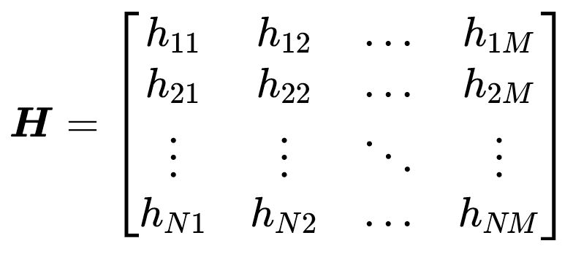
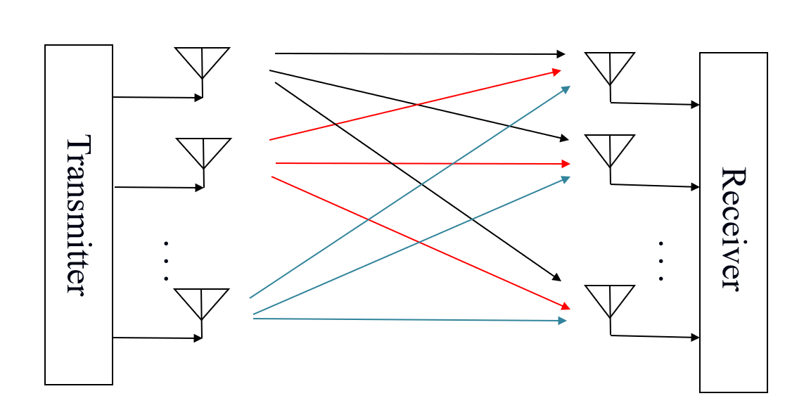
The standard channel capacity formula for MIMO:
det:determinant 行列式

Slide 35
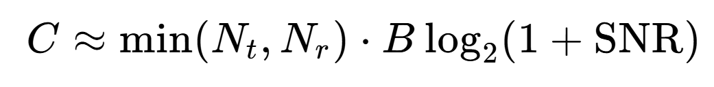
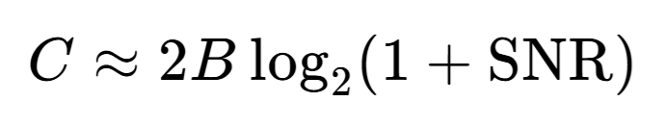
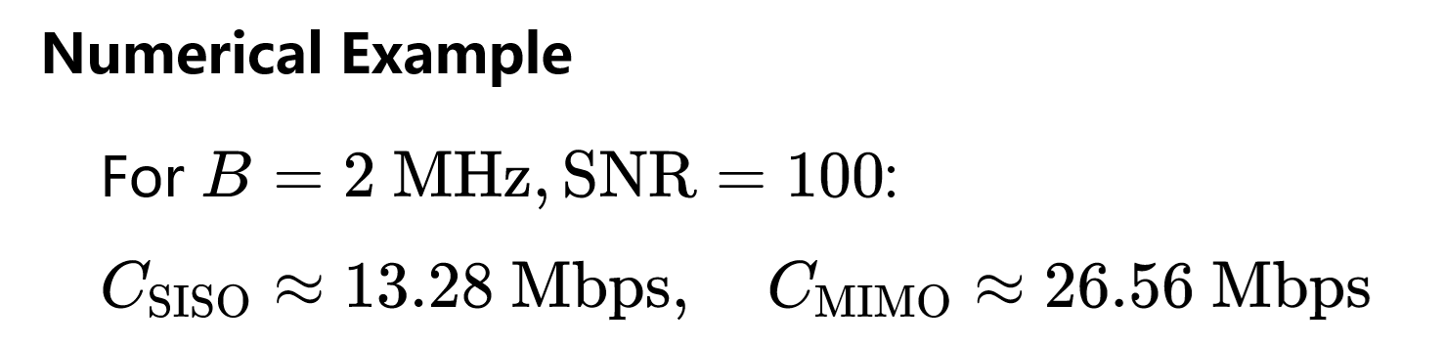
The standard channel capacity formula for MIMO:
Approximate MIMO Capacity Formula
(High SNR & Rich Scattering)
Special Case: 2×2 MIMO

Slide 36
Approximate MIMO Capacity Formula
(High SNR & Rich Scattering)
Link | Antenna Config | min(Nt, Nr) | Channel Capacity
Downlink | 4×2 MIMO (BS 4Tx, UE 2Rx)
Uplink | 1×4 (UE 1Tx, BS 4Rx)

Slide 37
作业
3.2 A voice-grade channel of the telephone network has a bandwidth of 3.4kHz.
(a)Calculate the information capacity of the telephone channel for a signal-to-noise ratio of 30dB
(b) Calculate the minimum SNR required to support information transmission through the telephone channel at the rate of 9600bps

Slide 38
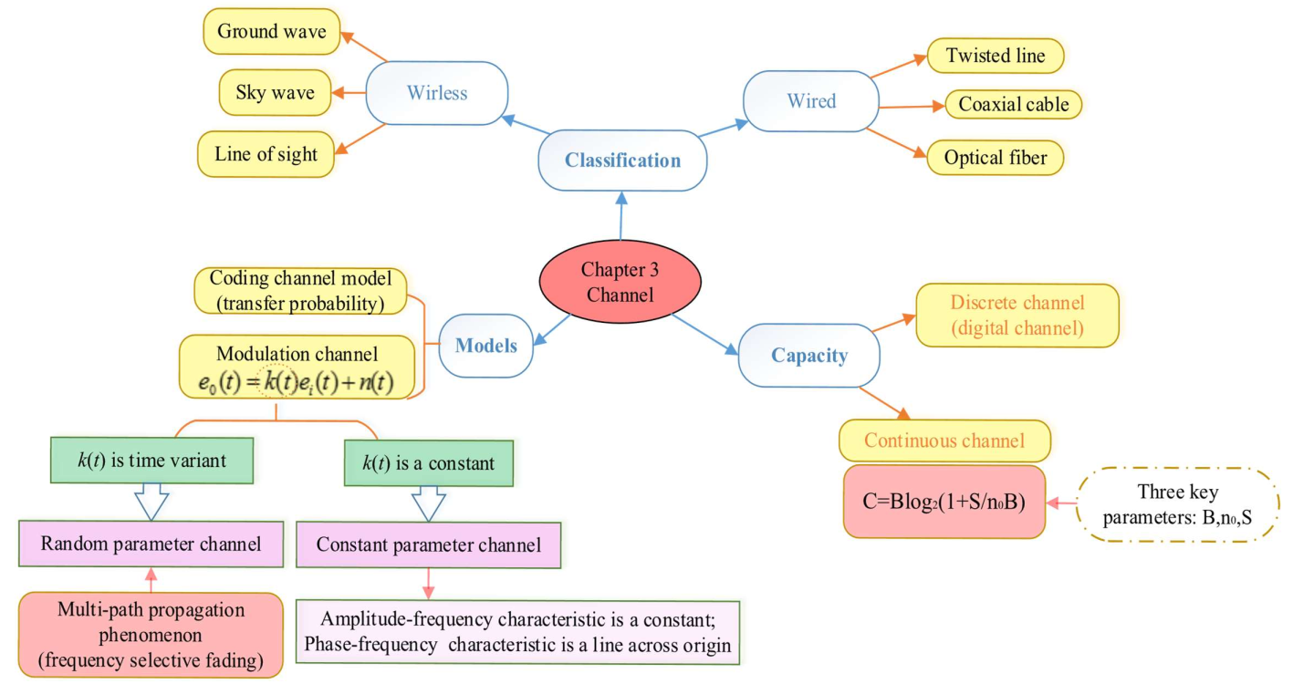
Mind map

Slide 39


Slide 40

双节大礼包
第一章 习 题 + 思维导图 + Brief summary(精练）
第二章 作业清单
+ 思维导图（2人讨论完成，互签）可打印可手写
+ Brief summary（精炼）手写
第三章 作业清单+思维导图+summary

Slide 41


Slide 42


